Slide 1
Testing Memory for Reward Distributions in 3D Virtual environments

Slide 2
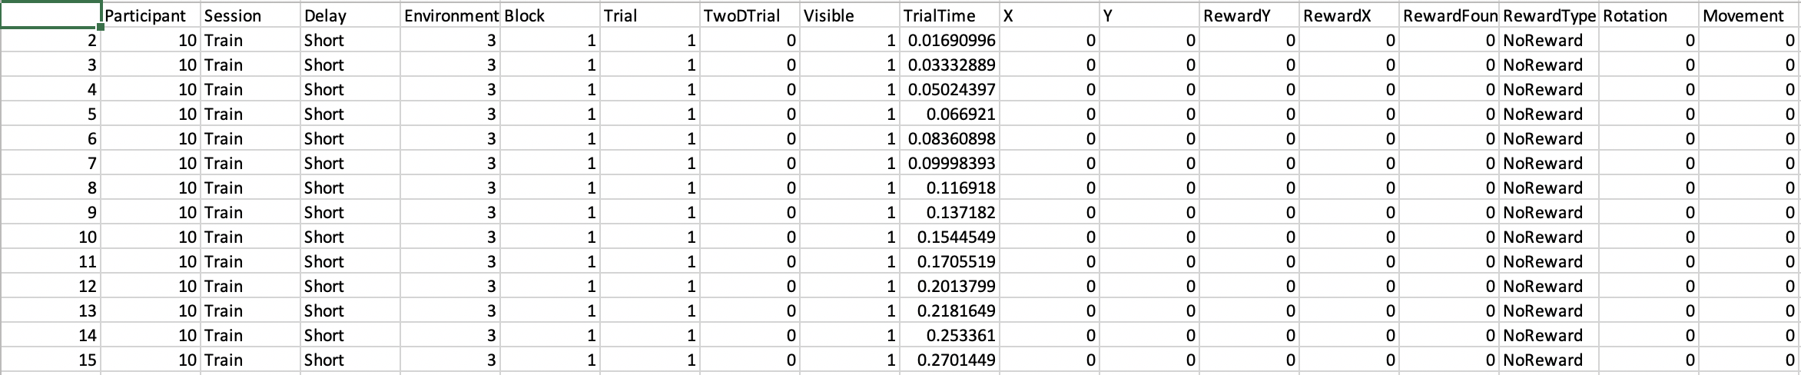
(x,y) coordinated
Of participant
1 = participant
Collected reward
Delays between Train
And Test Sessions:
1. Short (3hrs)
2. Long 24
2 Environments:
2 = Rural
3 = Urban
F = Food, M = Money,
W = Water
0 = 3D trials
1 = 2D trial
Time since
trial started
(x,y) Location of Reward
Participant is rotating in place = 1*
Two Sessions:
1. Train
2. Test
Trials are organized
Into blocks
Reward is:
0 = invisible
1 = visible
Participant is moving = 1*
*Note: Participants can only move forward or backwards or rotate in place. If movement = 0 and
Rotation = 0 they are standing in place. Movement and Rotation can never both be 1

Slide 3
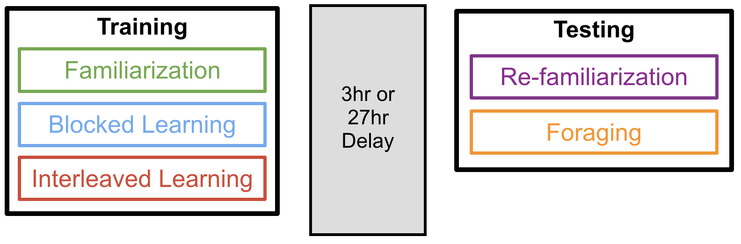
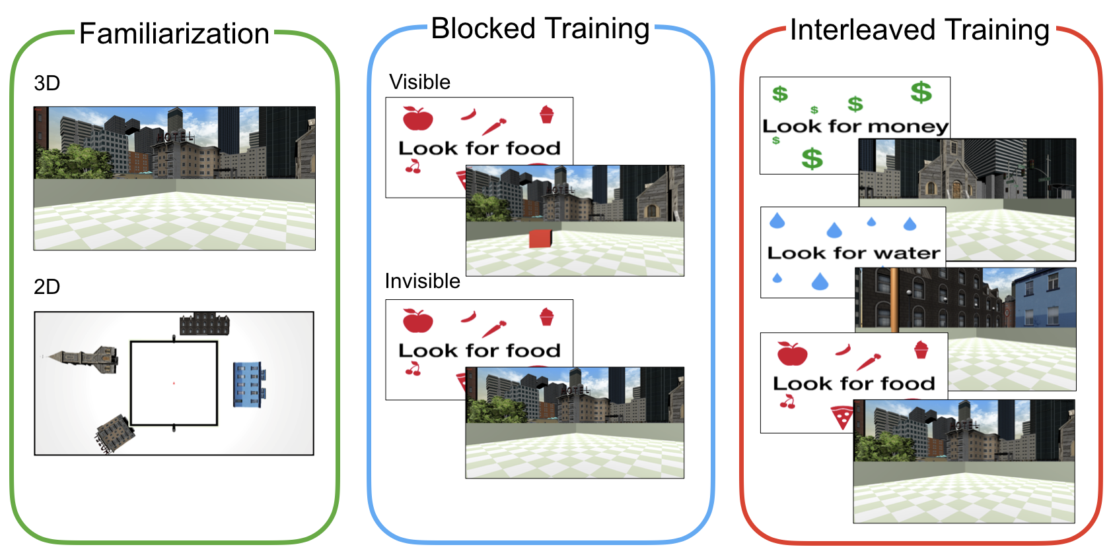
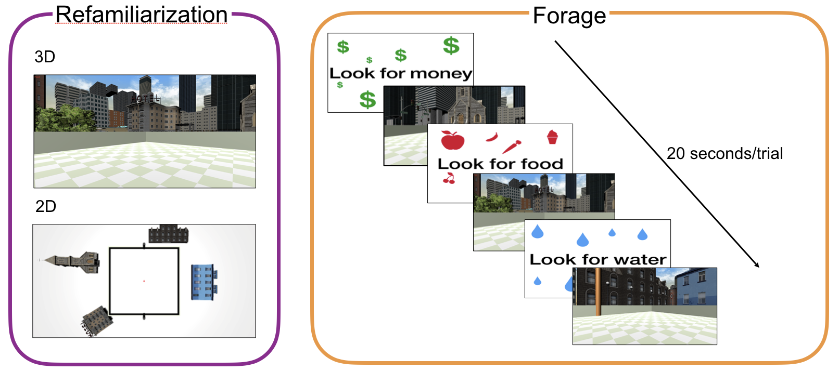
Task Procedure
1
2
3
1
4
Test
1. During Familiarization and refamiliarization participants explore the environment freely, they are asked periodically to identify their position on an allocentric map.
2: Blocked training occurs for each reward item. Participants complete several visible trials, then several invisible trials.
Each trial the participant is cued with the reward item the are to look for then placed into the environment and instructed
To find it
3: Interleaved training is completely randomized and 90% of rewards are invisible. There is a one visible trial for each reward type that occurs in within the first 13 trials of the interleaved block, Participants are cued with a
4: During test participants are cued with random rewards and have 20 seconds on each trial to find them. They aren’t given any feedback whether they found the reward or not.
Notes:
Procedure
In this 2-by-2 between subject design, each participant was assigned to one of two delay conditions: long (27hr) or short (3hr), and to one of two environmental conditions: Environment 1 or Environment 2 (n=11 per condition combination). The experiment consisted of a Training and a Test Session. During the training session, participants learned the locations of three goal types (i.e. food, water, money) by finding visible and hidden objects. Goal objects were placed within a 2-dimensional Gaussian distributions corresponding to the goal type. The centre of each goal distribution was placed in polar coordinates (r = 7.5m) with equal rotational distance (120 degrees) separating each distribution and a standard deviation of 2 metres (Fig. 1C).
Session 1: Training: The encoding session consisted of 3 blocks: Familiarization, Blocked Learning, and Interleaved Learning.
Block 1 – Familiarization: During each of 8 familiarization trials participants were placed into their assigned environment at a random location and their viewpoint was rotated 360 degrees. Once the rotation was complete, participants were instructed to move freely around the environment for 10 seconds. Participants were then shown a bird’s eye view of the environment and asked to move an arrow from the centre of the arena to their last location and then press spacebar. The next trial would then begin.
Block 2 –Blocked Training: were trained on the locations of three goals: Food, Water and Money. Goals were always trained in the same order (Food, Water, Money) beginning with 12 visible learning trials followed by 15 invisible trials.
Visible Training Trials: Participants were first cued with a screen indicating their current goal and then placed into the environment. As in the familiarization block, participants were placed at a random location and their view was rotated 360 degrees. Each trial included one visible goal object: a coloured 3D cube (Food = red, Water = blue, Money = green), positioned according to its corresponding goal distribution. Participants were instructed to collect the object as quickly as possible and given 10 seconds to do so. Upon collecting the object, the participant heard a sound associated with the goal type and the next trial began. If the object was not collected in time, the trial ended and the next trial began. On every other trial, participants were asked to locate where they had found the object on a bird’s eye map, like in the familiarization phase.
Invisible Training Trials: This block was identical to the Visible Training block with the following exceptions: (1) goal-objects were invisible and participants were instructed to find them using their , and (2) they were given 15 seconds to complete a trial.
Block 3 - Interleaved Training: Interleaved Training began after completing Blocked Training for each of the three goals. Participants were cued with one of the three goals, placed into the environment, and given 15 seconds to find it. All goal objects were invisible with the exception of one visible trial per goal which occurred within the first 10 trials of the block. Goal order was determined pseudorandomly with 12 trials for each goal type.
Session 2: Testing: The Testing session consisted of a Refamiliarization and a Foraging Block.
Block 1 - Refamiliarization: The Refamiliarization lock procedure was identical to the familiarization block during encoding.
Block 2 – Foraging: Participants were told that a large number of objects were hidden on each trial and that their job was to find as many as possible in 20 seconds using what they learned in the first session. The relevant type (food, water, money) was cued at the beginning of each trial, then participants were placed at a random arena location. Goal order was pseudorandomized with 26 trials per goal. No feedback was given.

Slide 4
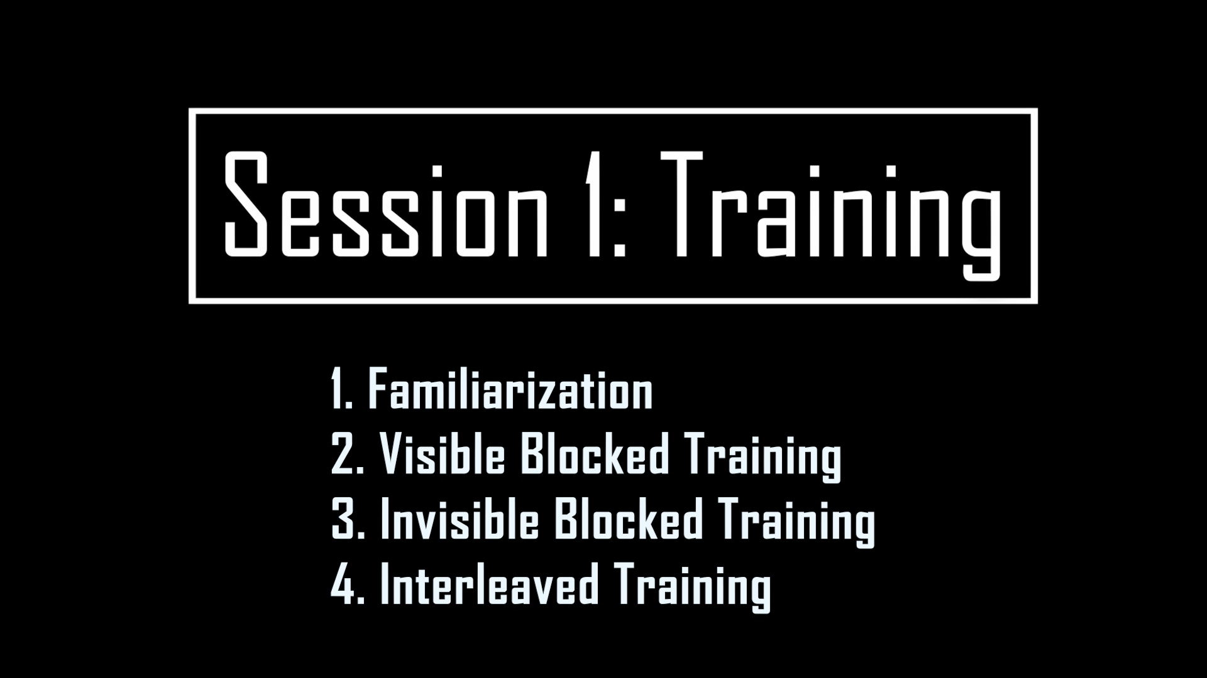

Slide 5
Reward Generation
Rewards are randomly generated on a 2D gaussian distribution
Ex. Reward
1 SD = 2 units
2 SD = 4 units
Back to Contents

Slide 6
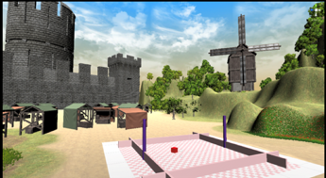

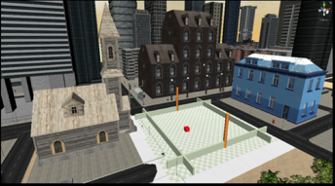

Experiment was created using OpenMaze and Unity
OpenMaze How to:
https://duncanlab.github.io/OpenMazeSite/
OpenMaze Download:
https://github.com/DuncanLab/OpenMaze
https://unity.com/
Notes:
As the inevitable goal is to monitor memory integration in the hippocampus across both mice and humans, I used an adapted version of the Morris Water Maze task—as it has been demonstrated to HC-dependent in both species.
As you can see on the right I created arena-like enclosures within two district global environments.Importantly these enclosure could be manipulated to created related encoding experiences.
like a watermaze all participant movement was confined to these arenas.
To create these environments and the experiment I built OpenMaze - a new 3D experimental design software package, using the Unity Game Development Engine.
Beyond this experiment, OpenMaze allows other researchers to easily code 3D virtual environment experiments with no prior coding knowledge.

Slide 7
Challenges!
Easy
Write a script to aggregate and clean up the individual Particiapnt Data
Medium
Do participants remember where to find rewards?
Does the environment matter?
Does the delay between training and testing matter?
Hard
Can you predict how well participants are going to perform in the testing phase by how they performed in the training phase?

Slide 8
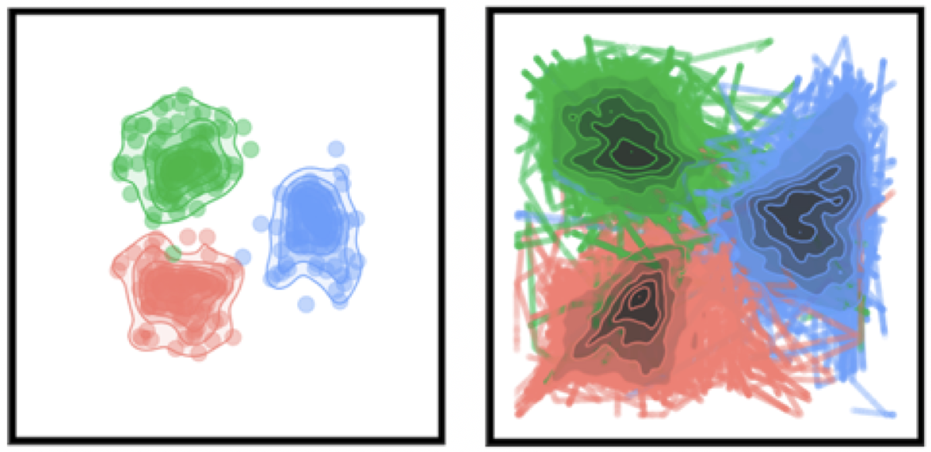
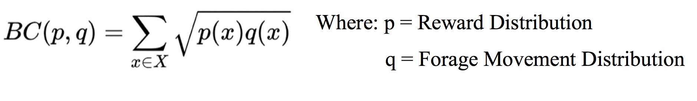
Analysis Idea: Bhattacharyya Coefficient
Rewards Found
Movement during Test

